Slide 1
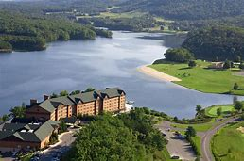
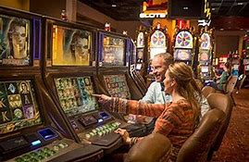

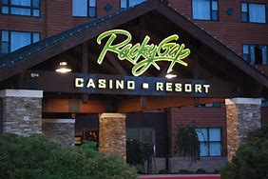

ALLEGANY COUNTY
LOCAL DEVELOPMENT COUNCIL
ROCKY GAP SLOTS ALLCOCATION

Slide 2
Allegany county – local development council
2007 Maryland General Assembly authorized slots in Maryland
Allowed for a 2.75% Local Impact Grant for Counties with a Slots Facility, adjusted to 3.75% in 2017, and moved to 5.5% on July 1, 2022
Based upon Video Lottery Terminal(VLT) proceeds at each facility located within a County
In Allegany County specifically, funds must be used:
Within the limits of Allegany County
On:
Infrastructure
Facilities
Public Safety
Sanitation
Economic and Community Development, including housing
Rocky Gap Debt Service - $4.9M borrowed -1996 ($400K/year Debt Service – Paid in Full FY 17)

Slide 3
Allegany county – local development council
A Local Development Council must be established for Each County Receiving a Local Impact Grant
15 Member Council Comprised of:
1 State Senator
2 Delegates
1 Casino Representative
7 Residents in the vicinity of the Casino
4 Businesses in the vicinity of the Casino
Established by the Allegany County Commissioners May 1, 2014
Responsible to comment on existing spending plan and recommend any changes to Allegany County Commissioners

Slide 4
Allegany county – local development council
Current Allocation of Local Impact Grant: Set with Resolution 24-13– effective July 1, 2024 with the estimate of $2,700,000 in proceeds for FY 2025
First $10,000 to first responders to Rocky Gap Casino, then:
20% - Municipalities and Non-Profit Organizations in Allegany County for Capital Projects - $540,000 currently
17% - Allegany College of Maryland Scholarship Fund - $360,000 Cap
9.25% - Frostburg State University - $200,000 Cap
4% - Board of Education - Capital Projects - $80,000 Cap
4% - Allegany County PAYGO Capital Projects - $80,000 Cap
2.25% – Ballistic Vests for Local Law Enforcement Agencies - $50,000 Cap
39.5% - Fire Companies $865,939 Cap
Divided evenly amongst companies
4% to remain unallocated and awarded annually – the first $250,000 is currently allocated to Allegany County EMS
$100,000 allocated to Rocky Gap Casino Resort for a shuttle service to Canal Place
Any remainder is to be awarded as grants at the end of the fiscal year

Slide 5
Allegany county – local development council
Fiscal Year 2024 Results vs 2025 budget results:
2024 2025
Fire Companies – $875,939 $875,939
Allegany County EMS $250,000 $250,000
Allegany College of Maryland - $360,000 $360,000
Municipality & Non-Profit Grants $534,668 $540,000
Frostburg State University - $200,000 $200,000
Allegany County PAYGO - $80,000 $80,000
Board of Education Capital - $80,000 $80,000
Law Enforcement Ballistic Vests $50,000 $50,000
Rocky Gap Transit $100,000 $100,000
Unallocated - Grants $150,000 $164,061
GRAND TOTAL COLLECTED - $2,680,607 $2,700,000

Slide 6
Allegany county – local development council
Restrictions and Considerations regarding Use of Funds:
20% is required by State Law to be distributed to Municipalities and/or Non-profits for their use in capital projects
2025 budget shows this to be $600,000 – as of today, we are on pace to hit this amount(We estimate $2.9M to $3.0M total for FY 25)
During 2024, we distributed $534,668
3 municipalities
18Non-Profits
3 Fire Departments
Average Grant was $22,277 and grants ranged from $2,000 to $68,000
Unallocated Dollars were awarded for 2 one-time grants – CEDC for Downtown Marketing and 1812 for a waterline extension for their new production facility
Total awarded was $150,000
State Law now requires a multi-year plan – this should be part of our decision making this year.
Frostburg State is asking to repurpose $150,000 allocated to the Challenger Center to their Planetarium – we will need to take action.
QUESTIONS, CONCERNS, DISCUSSION?

