Slide 1

Allegany County Commissioners
FY 2025
Preliminary Budget
Jason M. Bennett| Administrator| May 2, 2024

Slide 2

Preliminary Budget Highlights –
Total Requested Revenues $112,238,740
Highlights | Changes | Reasoning
Property Taxes | $1,386,132 | Property taxes 2.9% growth due to rising assessments
Income Taxes | ($3,000,000) | Decrease in tax rate and decrease in FY 2024 and anticipated FY 2025 performance
Other Taxes | ($1,010,000) | Decrease in Recordation & Transfer taxes due to decrease in real estate sales
Disparity Grant | $1,794,075 | Increased back to level funding
Interest Income | ($1,199,250) | Anticipated interest rate decreases and use of existing investment reserve

Slide 3
Preliminary Budget Highlights –
Total Requested Expenditures $112,238,740
Highlights - Operating Departments | Changes | Reasoning
Emergency Management | $489,874 | Continued expansion; Expenditures total $7M and now our 3rd largest operating department
State’s Attorney | $470,780 | Continued expansion; Expenditures total $2.6M
Debt Service Transfer | $(648,975) | Decrease – PIB Bond Paid Off

Slide 4
FY 2025 Proposed Tax Rates
INCOME TAX RATE | 3.03%
REAL PROPERTY TAX RATE | $0.9750
RECORDATION TAX | $3.50
HOMESTEAD CREDIT | 4.00%

Slide 5
Total FY 2025 Budget Revenues $112,238,740
Notes:
Check %s

Slide 6
FY 2025 Recommended Budget
Revenues & Other Sources Summary
General Fund | $ 112,238,740
Coal Haul Roads Fund | 54,000
Rocky Gap Slots Revenue Fund | 2,495,939
Transit Fund | 2,820,105
Narcotics Task Force Fund | 284,682
Gaming Fund | 419,863
Revolving Building Fund | 6,654,177
State Fire, Rescue & Inmate Commissary Fund | 537,358
Debt Service Fund | 2,452,796
Water Fund
Sanitary Fund
Allconet II | 116,500
County Loan Fund | 218,000
TOTAL | $ 128,292,660
Note: This preliminary budget does not include the Capital Projects Fund or Water/Sewer Funds

Slide 7
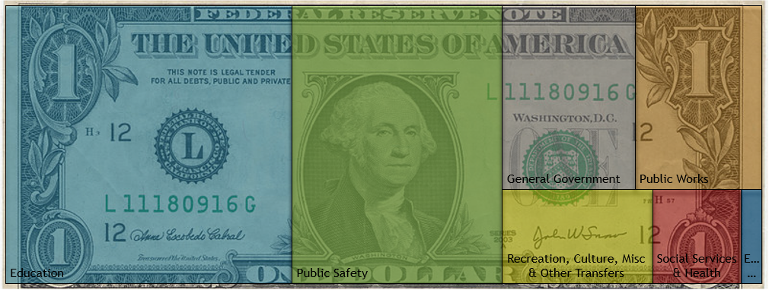
Total FY 2025 Budget Expenditures $112,238,740
Where Is Your Tax Dollar Spent?
11.34%
11.26%
7.21%
0.90%
38.00%
27.71%
3.58%
Economic Development
Notes:
% don’t update on own

Slide 8
FY 2025 General Fund Expenditures
Notes:
Check %s

Slide 9
FY 25 Budget General Fund
Services Not Provided by Municipal Government

Slide 10

FY 2025 Budget
Debt Service Transfer $1,887,283

Slide 11

 | Actual 2021 | Actual 2022 | Actual 2023 | Budgeted 2024 | Budgeted 2025
County Appropriation | 7,706,856 | 7,706,856 | 8,206,856 | 8,331,856 | 8,331,856
Percentage Change | 0.0% | 0.0% | 6.5% | 1.5% | 0.0%
Support For
County Appropriation | 7,706,856 | 7,706,856 | 8,206,856 | 8,331,856 | 8,331,856
Allegany County Campus Enrollment | 1,850 | 1,782 | 2,109 | 1,837 | 2,289
Appropriation Per Student | 4,166 | 4,325 | 3,891 | 4,536 | 3,640
Percentage Change | 16.0% | 3.8% | -10.0% | 16.6% | -19.8%
County Appropriation + Debt Service | 8,014,057 | 7,811,867 | 8,309,916 | 8,537,634 | 8,445,125
Allegany County Campus Enrollment | 1,850 | 1,782 | 2,109 | 1,837 | 2,289
Spending Per Student | 4,332 | 4,384 | 3,940 | 4,648 | 3,689
Percentage Change | 15.4% | 1.2% | -10.1% | 18.0% | -20.6%
Note: Numbers do not include $360,000 appropriated annually to the ACM Foundation from Rocky Gap Slots Proceeds.
Notes:
Budgeted % change compared to PY budgeted numbers – not actual
Enrollment = FTE

Slide 12

 | Actual 2021 | Actual 2022 | Actual 2023 | Budgeted 2024 | Budgeted 2025
County Appropriation | 30,734,335 | 31,854,912 | 31,854,912 | 34,204,700 | 33,868,357
Percentage Change | 0.0% | 3.6% | 0.0% | 7.4% | -1.0%
 |  | 31,854,912
Support
For
County Appropriation | 30,734,335 | 31,854,912 | 31,854,912 | 34,204,700 | 33,868,357
Student Enrollment | 8,075 | 8,132 | 8,205 | 8,181 | *8,205
Appropriation Per Student | 3,806 | 3,917 | 3,882 | 4,181 | 4,128
Percentage Change | -1.5% | 3.0% | -1.0% | 6.7% | -1.3%
County Appropriation + Debt Service | 32,144,216 | 32,156,454 | 32,531,502 | 35,536,892 | 34,560,418
Student Enrollment | 8,075 | 8,132 | 8,205 | *8,181 | *8,205
Spending Per Student | 3,981 | 3,954 | 3,965 | 4,344 | 4,212
Percentage Change | -1.7% | -0.7% | 0.3% | 8.6% | -3.0%
County Appropriation + Debt Service + Gaming | 32,144,216 | 32,651,311 | 32,801,502 | 35,615,136 | 34,697,601
Student Enrollment | 8,075 | 8,132 | 8,205 | *8,181 | *8,205
Spending Per Student | 3,981 | 4,015 | 3,998 | 4,353 | 4,229
Percentage Change | -1.7% | 0.9% | -0.4% | 8.2% | -2.8%
*Enrollment value at 9/30/23, which is the measurement date for foundational state aid, provided by Larry McKenzie
Note: Enrollment numbers include Pre-K student enrollment.
Notes:
Budgeted % change compared to PY budgeted numbers – not actual

Slide 13
Changes to Requests FY25 Preliminary Budget
General Fund Unexpended Fund Balance requested to be used before changes: $13,105,604
  After below changes: $6,542,022
Changes Made to Requests (Reflected in Preliminary Recommended Budget):
  Credit Card Fees $ (500,000) Revenue Increase
  Removing Capital Outlay Requests (1,946,926) Expenditure Decrease
  Level Funding to Outside Agencies (800,000) Expenditure Decrease
  Cut Overtime Requests 50% (850,000) Expenditure Decrease
  Freeze Open Positions (996,656) Expenditure Decrease
  Cut 20 Positions (Then Frozen) (1,620,000) Expenditure Decrease
  Increase 911 Fee (.75 to 1.5) (450,000) Revenue Increase
  Georges Creek Ambulance Acquisition 600,000 Expenditure Increase (EMS)

Slide 14
Possible Additional Cuts for Consideration – FY25 Budget
GF Unexpended Fund Balance still at $6,542,022 for FY25 Budget
FY24 General Fund estimated at a deficit – will affect fund balance
Additional Cuts to Consider for the FY25 Budget
  Cut General Fund Dept Operating Expense Budgets 10% $1,200,000 Savings
  Cut Outside Agencies Budgets by 10% 1,100,000 Savings
  Increase Trash Stickers $1 250,000 Savings
  Increase 911 Fee further - $1.50 to $2.25 450,000 Savings
  Public Safety Tax – 5 cents per $100/assessments 2,400,000 Savings

Slide 15
Budget Information
There will be preliminary budget hearings for public input during all meetings in May.
This document is available online at www.alleganygov.org
Please feel free to email any questions about this document to finance@alleganygov.org
Budget Adoption is scheduled for May 30, 2024.

