Slide 1

Allegany County Commissioners
FY 2020
Preliminary Budget
Jason M. Bennett| Director of Finance| May 9, 2019

Slide 2

Preliminary Budget Highlights –
Total Requested Revenues $91,788,864
Highlights | Changes | Reasoning
Property Taxes | ($442,448) | Property taxes below constant yield DNR Pilot reduced by $340,000
Income Taxes | $1,045,969 | Strong FY 2019 performance
Ambulance Fees | $80,000 | Expanded coverage area
Unexpended Fund Balance | ($717,474) | Decrease from $1,571,596 used for FY 2019

Slide 3
Preliminary Budget Highlights –
Total Requested Expenditures $91,788,864
Highlights - Operating Departments | Changes | Reasoning
Salaries & Fringe Benefits | $455,000 | 2% COLAs No Health Insurance Increase
EMS | $294,964 | Expansion of services
Appropriations to Major Outside Agencies | $410,527 | 1% Increase to Board of Education, Allegany College, Allegany County Health Department, Allegany County Library
Debt Service | ($510,763) | Bond Premium of $862K for 2018 PIB used for FY 2020 Debt Service Payment

Slide 4
FY 2020 Proposed Tax Rates
NO CHANGE IN RATES
INCOME TAX RATE | 3.05%
REAL PROPERTY TAX RATE | $0.9750
RECORDATION TAX | $3.50
HOMESTEAD CREDIT | 4.00%

Slide 5
Total FY 2020 Budget Revenues $91,788,864

Slide 6
FY 2020 Recommended Budget
Revenues & Other Sources Summary
General Fund | $ 91,788,864
Coal Haul Roads Fund | 70,000
Rocky Gap Slots Revenue Fund | 3,125,038
Transit Fund | 3,880,499
Narcotics Task Force Fund | 115,462
Gaming Fund | 415,005
Revolving Building Fund | 13,274,358
State Fire, Rescue & Inmate Commissary Fund | 415,970
Debt Service Fund | 3,364,253
Water Fund | 4,465,843
Sanitary Fund | 8,423,133
Allconet II | 225,058
County Loan Fund | 28,608
TOTAL | $ 129,592,091
Note: This preliminary budget does not include the Capital Projects Fund.

Slide 7
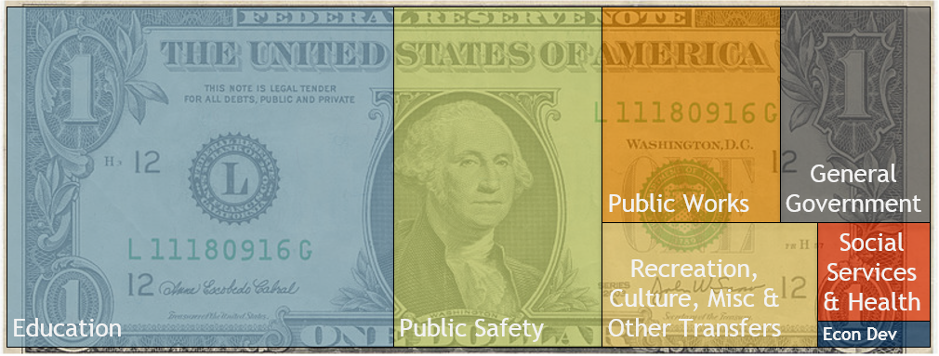
Total FY 2020 Budget Expenditures $91,788,864
Where Is Your Tax Dollar Spent?
10.30%
12.20%
8.55%
3.55%
41.88%
22.59%
0.93%

Slide 8
FY 2020 General Fund Expenditures

Slide 9
FY 20 Budget General Fund
Services Not Provided by Municipal Government

Slide 10

FY 2020 Budget
Debt Service Transfer $3,193,321*
* Includes $862,000 in bond premium used to pay the FY 2020 debt service payment for the 2018 PIB

Slide 11

 | Actual 2016 | Actual 2017 | Actual 2018 | Budgeted 2019 | Budgeted 2020
County Appropriation | 7,555,000 | 7,630,550 | 7,630,550 | 7,630,550 | 7,706,856
Percentage Change | 0.0% | 1.0% | 0.0% | 0.0% | 1.0%
Support For
County Appropriation | 7,555,000 | 7,630,550 | 7,630,550 | 7,630,550 | 7,706,856
Allegany County Campus Enrollment | 2,711 | 2,466 | 2,286 | 2,222 | 2,181
Appropriation Per Student | 2,787 | 3,094 | 3,338 | 3,434 | 3,534
Percentage Change | (6.8%) | 11.00% | 7.3% | 5.8% | 2.8%
County Appropriation + Debt Service | 7,967,922 | 7,894,268 | 7,894,897 | 7,890,487 | 8,033,988
Allegany County Campus Enrollment | 2,711 | 2,466 | 2,286 | 2,222 | 2,181
Spending Per Student | 2,939 | 3,201 | 3,454 | 3,551 | 3,684
Percentage Change | (5.6%) | 8.9% | 7.3% | 5.8% | 3.6%
Note: Numbers do not include $360,000 appropriated annually to the ACM Foundation from Rocky Gap Slots Proceeds.

Slide 12

 | Actual 2016 | Actual 2017 | Actual 2018 | Budgeted 2019 | Budgeted 2020
County Appropriation | 29,837,545 | 30,169,985 | 30,424,308 | 30,424,308 | 30,734,335
Percentage Change | 1.4% | 1.1% | 0.8% | 0.0% | 1.0%
Support
For
County Appropriation | 29,837,545 | 30,169,985 | 30,424,308 | 30,424,308 | 30,734,335
Student Enrollment | 8,691 | 8,597 | 8,539 | 8,629 | 8,673
Appropriation Per Student | 3,433 | 3,509 | 3,563 | 3,526 | 3,544
Percentage Change | 3.3% | 2.2% | 1.5% | 0.8% | 0.5%
County Appropriation + Debt Service | 31,764,630 | 32,032,848 | 31,934,392 | 31,913,850 | 32,235,205
Student Enrollment | 8,691 | 8,597 | 8,539 | 8,629 | 8,673
Spending Per Student | 3,655 | 3,726 | 3,740 | 3,698 | 3,717
Percentage Change | 3.3% | 1.9% | 0.4% | 0.8% | 0.5%
County Appropriation + Debt Service + Gaming | 31,901,026 | 32,112,848 | 32,014,392 | 31,993,850 | 32,315,205
Student Enrollment | 8,691 | 8,597 | 8,539 | 8,629 | 8,673
Spending Per Student | 3,671 | 3,735 | 3,749 | 3,708 | 3,726
Percentage Change | 3.3% | 1.7% | 0.4% | 0.8% | 0.5%
Note: Enrollment numbers include Pre-K student enrollment.

Slide 13
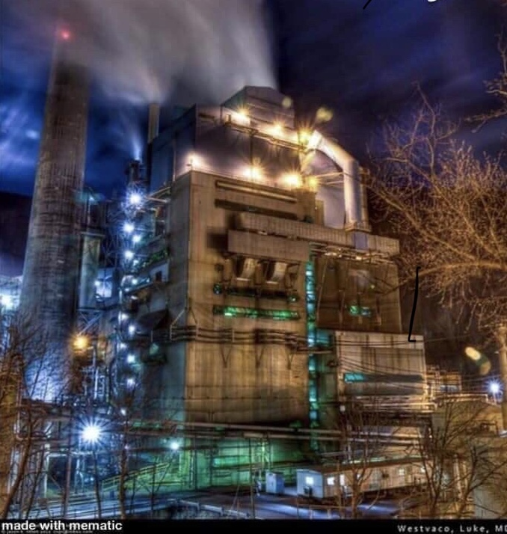
LUKE MILL CLOSURE
Loss of 675 jobs
  Plus loss of support service jobs
$310,000 decrease in annual property tax
Impact on annual income tax to be determined
At this time, there are too many unknowns. We will likely need a work session and potential budget amendment in the near future.

Slide 14
Budget Information
There will be a preliminary budget hearing for public input on:
    May 16, 2019
This document is available online at www.gov.allconet.org
Please feel free to email any questions about this document to finance@alleganygov.org
Budget Adoption is schedule for May 30, 2019.

